Slide 1
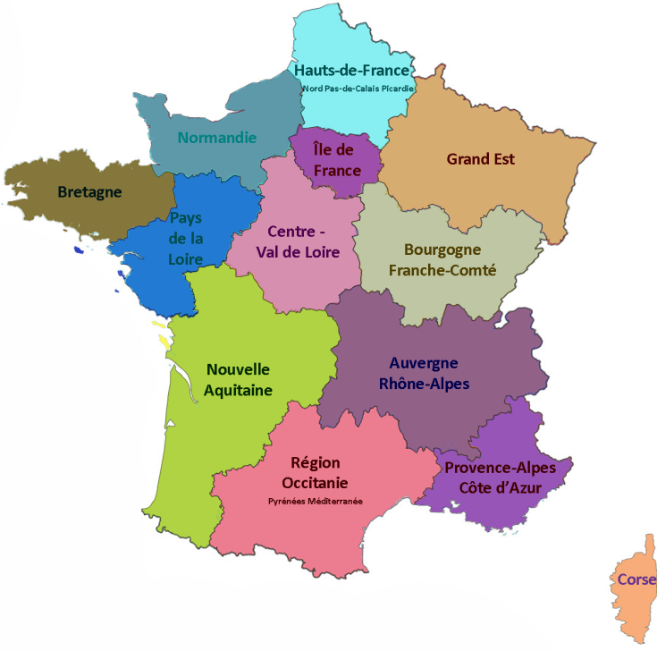
FRANCE
67 million inhabitants

Slide 2
FRANCE
67 million inhabitants
672 000 km² including overseas departments

Slide 3
FRANCE
67 million inhabitants
672 000 km² including overseas departments
18 regions since 2015 (12 in mainland)

Slide 4
FRANCE
67 million inhabitants
672 000 km² including overseas departments
18 regions since 2015 (12 in mainland)
101 departments

Slide 5
FRANCE
67 million inhabitants
672 000 km² including overseas departments
18 regions since 2015 (12 in mainland)
101 departments
13 000 intercommunalities

Slide 6
FRANCE
67 million inhabitants
672 000 km² including overseas departments
18 regions since 2015 (12 in mainland)
101 departments
13 000 intercommunalities
36 000 municipalities

Slide 7
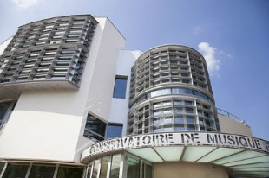
Music and art schools in France
Schools classified by the State
42 Conservatoires à Rayonnement Régional (CRR)

Slide 8
Music and art schools in France
Schools classified by the State
42 Conservatoires à Rayonnement Régional (CRR)
120 Conservatoires à Rayonnement Départemental (CRD)

Slide 9
Music and art schools in France
Schools classified by the State
42 Conservatoires à Rayonnement Régional (CRR)
120 Conservatoires à Rayonnement Départemental (CRD)
380 Conservatoires à Rayonnement Communal (CRC)

Slide 10
Music and art schools in France
Schools classified by the State
42 Conservatoires à Rayonnement Régional (CRR)
120 Conservatoires à Rayonnement Départemental (CRD)
380 Conservatoires à Rayonnement Communal (CRC)
Other schools
> 1500 public schools
> 2000 associations

Slide 11
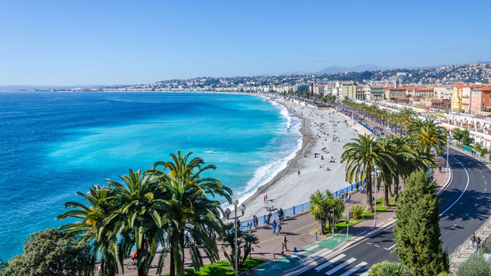
FFEA Fédération Française de l’Enseignement Artistique
Office in the city of Nizza

Slide 12
FFEA Fédération Française de l’Enseignement Artistique
Office in the city of Nizza
President : André Peyrègne
8 Board members

Slide 13
FFEA Fédération Française de l’Enseignement Artistique
Office in the city of Nizza
President : André Peyrègne
8 Board members
1 project coordinator

Slide 14
FFEA Fédération Française de l’Enseignement Artistique
Office in the city of Nizza
President : André Peyrègne
8 Board members
1 project coordinator
200 000 € budget / 15 000 € from the State

Slide 15
FFEA Fédération Française de l’Enseignement Artistique
Office in the city of Nizza
President : André Peyrègne
8 Board members
1 project coordinator
200 000 € budget / 15 000 € from the State
Fees : 50 € - 500 € p.y.

Slide 16
FFEA Fédération Française de l’Enseignement Artistique
Office in the city of Nizza
President : André Peyrègne
8 Board members
1 project coordinator
200 000 € budget / 15 000 € from the State
Fees : 50 € - 500 € p.y.
800 schools : the biggest and most diverse association in France

Slide 17
MISSION
Advocacy

Slide 18
MISSION
Advocacy
Coherence of music education
curricula

Slide 19
MISSION
Advocacy
Coherence of music education
curricula
examination programs

Slide 20
MISSION
Advocacy
Coherence of music education
curricula
examination programs
pedagogical scores by French composers

Slide 21
MISSION
Advocacy
Coherence of music education
curricula
examination programs
pedagogical scores by French composers
Services to our members
Special partnerships

Slide 22
MISSION
Advocacy
Coherence of music education
curricula
examination programs
pedagogical scores by French composers
Services to our members
Special partnerships
School insurance / Instruments insurance

Slide 23
MISSION
Advocacy
Coherence of music education
curricula
examination programs
pedagogical scores by French composers
Services to our members
Special partnerships
School insurance / Instruments insurance
Directors and Teachers health insurance

Slide 24
MISSION
Advocacy
Coherence of music education
curricula
examination programs
pedagogical scores by French composers
Services to our members
Special partnerships
School insurance / Instruments insurance
Directors and Teachers health insurance
Fees discounts on copyrights

Slide 25
MISSION
Advocacy
Coherence of music education
curricula
examination programs
pedagogical scores by French composers
Services to our members
Special partnerships
School insurance / Instruments insurance
Directors and Teachers health insurance
Fees discounts on copyrights
OFAJ : subsidies for school exchanges

Slide 26
PROJECTS
Advocacy at a regional level

Slide 27
PROJECTS
Advocacy at a regional level
New Website
communication with our members

Slide 28
PROJECTS
Advocacy at a regional level
New Website
communication with our members
Highlighting our members projects

Slide 29
PROJECTS
Advocacy at a regional level
New Website
communication with our members
Highlighting of our members projects
Exchange of good practices

Slide 30
PROJECTS
Advocacy at a regional level
New Website
communication with our members
Highlighting of our members projects
Exchange of good practices
Census and mapping of schools

Slide 31
PROJECTS
Advocacy at a regional level
New Website
communication with our members
Highlighting of our members projects
Exchange of good practices
Census and mapping of schools
Strengthening links with EMU

Slide 32
PROJECTS
Advocacy at a regional level
New Website
communication with our members
Highlighting of our members projects
Exchange of good practices
Census and mapping of schools
Strengthening links with EMU
Hosting a capacity building seminar

Slide 33
PROJECTS
Advocacy at a regional level
New Website
communication with our members
Highlighting of our members projects
Exchange of good practices
Census and mapping of schools
Strengthening links with EMU
Hosting a capacity building seminar
Onda Latina

Slide 34
FFEA Fédération Française de l’Enseignement Artistique
Thank you!

