Slide 1
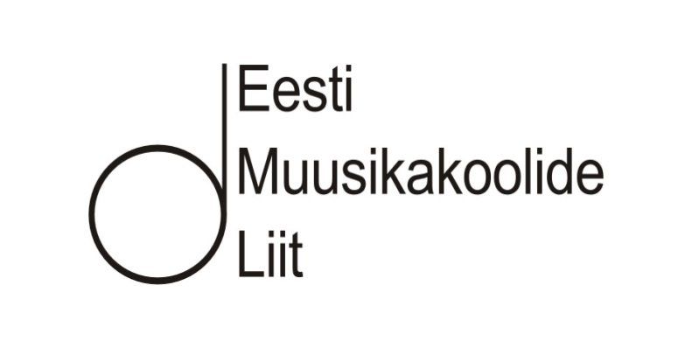
Estonian Music Schools Union
KADRI LEIVATEGIJA
March 30, 2017
Tallinn

Slide 2
Estonian population
General population: 1,3 mln
Youth (aged 5-19): 0,2 mln (15%)

Slide 3
Regional statistics
213 local municipalities in total, music schools* in 81
47 towns (population > 1000), music schools* in 41
116 music schools* all over Estonia
Research (2016):
20% of hobby schools pupils are the residents of different local municipality than the school is located;
somewhat higher percentage of music engages young people of related age groups is in the municipalities with better capabilities (by index ratings) > more NGOs and private institutions
* Music and arts schools that have music related curriculum(s)
(data as of Nov. 2016)

Slide 4
Co-ordinating institutions
Estonian Music Schools Union
Estonian Hobby Schools Union

Slide 5
Estonian Music Schools Union (EML)
non-profit organisation
unites 95 music and arts schools all over Estonia (82% of music and arts schools with music related curriculums)
students in total: ca 11 000
(5% of population aged 5-19)
teachers in total: ca 2000
management
Central level (6 board members)
Regional level (6 regions)

Slide 6
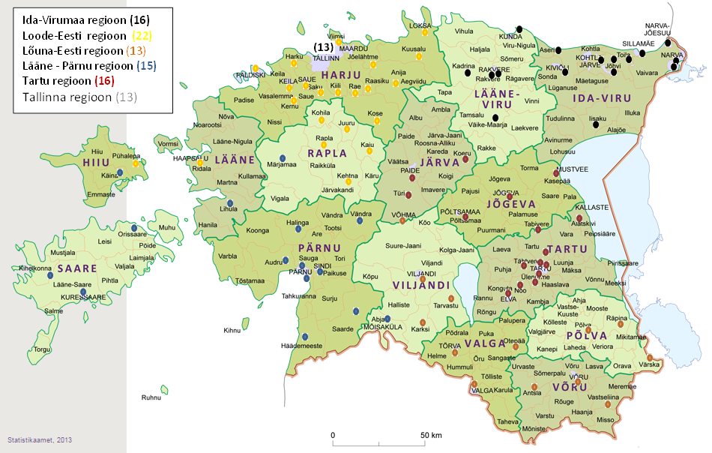
Regions and members

Slide 7
Diversity of members
3 secondary level music schools (Eller College, Otsa College and Tallinn Music High School)
Private sector: 6
Hobby centers: 9
Music and arts school where one can learn
folk music: 19
pop-jazz/rythm music: 10
vocal: 20.

Slide 8
Funding of music schools
Music education, as any hobby education, is youth field theme under Ministry of Education and Research > teacher status and funding issues:
- Music schools are funded by local municipalities,
significant differencies between the regions: availability- accessibilit > transportation, shortage of qualified staff, tuitution fee paid by parents;
Salary of youth field employees varies a lot, olny 4% of staff earns monthly more than 1000 € (2016);
Teacher in education system: state granted min salary is 1000 € (2017; was 958 € in 2016)
New developments: additional funding by state for hobby education and activities:
2018 – 15 mln €

Slide 9
Average wage in EML member institutions

Slide 10
Need for instrument teachers in member institutions 2016

Slide 11
Teachers age groups in music and art schools

Slide 12
Higher level educator institutions
Estonian Academy of Music and Theatre (EMTA)
University of Tartu Viljandi Culture Academy
Tallinn University

Slide 13
Main activities of EML
Organizing regional and republican competitions for all academic instruments incl. harpsichord, recorder, organ.
In the future may also be included folk and rhythm music instruments.
Republican contest "The best young instrumentalist 2017„
instruments this year: bassoon, flute, clarinet, piano, harpsichord, horn, oboe, organ, recorder, saxophone, trumpet and low brass.
Pre-contests in six regions carried out by 22 Music Schools, involved ca 575 young musicians from all over Estonia.
Final contest took place 04. - 25.3.2017, participants ca 350.
In total ca 90 members of the juries.
The development and training programs for teachers and head-masters, creation of new teaching materials
Music history, solfege (e.g.dictation) etc.

Slide 14
Main activities of EML (2)
Cooperation with different professional associations:
Piano Society, Estonian Piano Teachers' Association, Estonian Flute Union, Erta, Estonian Harpsichord guild, Estonian Wind Music Society, Estonia Saxophone Association, Violin Society etc.
Develompent and funding related negotiations with
Ministry of Education and Research
Ministry of Culture
Government Office of Estonia (ILOP)
EMTA

Slide 15
EML basic financing
Annual membership fee:
€ 2 per student of member institution
In total: € 22 thousand

Slide 16
EML is member of EMU since 2001
representative of EML is a member of the EMU Presidium
representative of EML is a member of the Estonian Music Council

Slide 17
Challenges and possibilities Internal
Create and publish new study materials
Organize republican competitions for all instruments, organize feed-back
Website management, info up-dates
Apply for additional finances to fund development projects
Recognition of teachers and headmasters
Organize pedagogical trainig cources

Slide 18
External
Collaboratiton with different
professional associations
music and creative unions
colleges, high schools, academies, universities
Music education development related negotiations with
Ministry of Education and Research
Ministry of Culture
Participation in various cultural funds committees

Slide 19
International
Organize international cooperation with EMU, Nordic countries and Visegrad group
Intermediation of international relations and contacts

Slide 20
Thank You for Your attention!

